Slide 1
Chapter 7 Basic Sequential Circuits
Latches
Flip-Flops
Registers
Counters

Slide 2
Logic circuits
Combinational circuits
  Outputs only depend on present inputs
  Examples: muxes, demuxes, encoders, decoders, comparators, and adders
Sequential circuits
  Outputs depend on present inputs AND past behavior of the circuit
  Examples: latches, flip-flops, registers, and counters

Slide 3
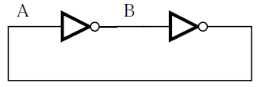
A memory element
Storage/memory elements are circuits that store the values of logic signals.
Two cascaded inverters
Two possible states
  A=0, B=1
  A=1, B=0
Not useful: states cannot be changed

Slide 4
Latches
A latch is a circuit that can store one bit of information.
Latches
  Basic SR latch
  Gated SR latch
  Gated D latch

Slide 5
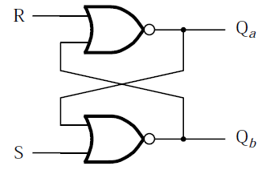

Basic SR latch
Basic SR latch
  Circuit: two cross-coupled NOR gates
  S: set signal
  R: reset signal
  Left to right: circuit and circuit symbol
Source: https://en.wikibooks.org/wiki/Digital_Circuits/Latches

Slide 6
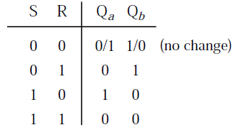
Basic SR latch
Characteristic table
  S=0, R=0: latched/hold/no change
  S=0, R=1: reset (Q_{a}=0, Q_{b}=1)
  S=1, R=0: set (Q_{a}=1, Q_{b}=0)
  S=1, R=1: illegal/not allowed/metastable

Slide 7
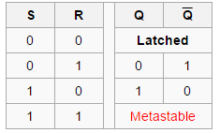
Basic SR latch
Characteristic table (alternate)
S and R are active high signals.
Source: https://en.wikibooks.org/wiki/Digital_Circuits/Latches

Slide 8
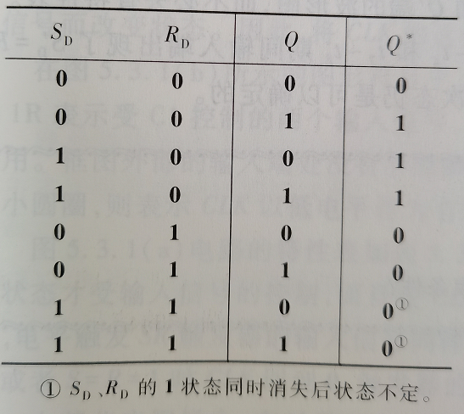
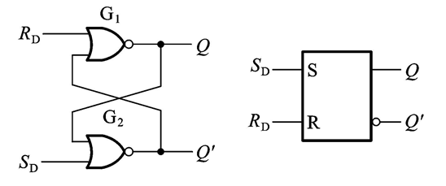
Basic SR latch
Characteristic table (alternate)

Slide 9
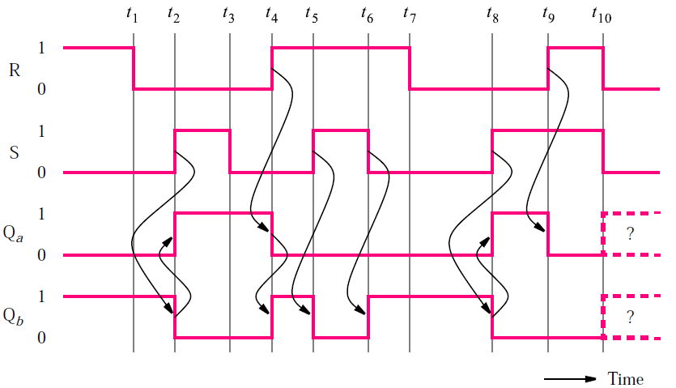
Basic SR latch
Timing diagram (assume no propagation delay)

Slide 10
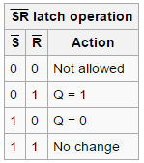
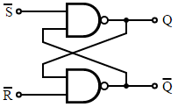

Alternate basic SR latch
Implementation: NAND gates
Set and reset are active low signals.
Left to right: circuit, circuit symbol, and characteristic table
Source: https://en.wikipedia.org/wiki/Flip-flop_(electronics)

Slide 11
Gated SR latch
Gated SR latch
  Add a signal to control the time when the set and reset signals change values
Two implementations
  NOR gates
  NAND gates

Slide 12
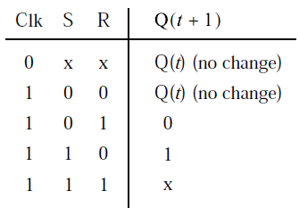
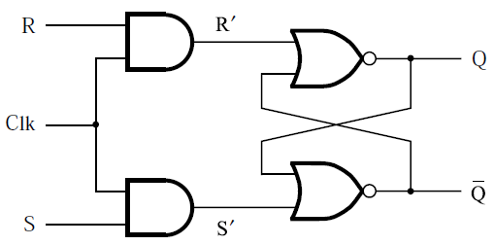
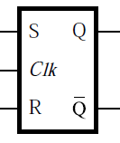
Gated SR latch with NOR gates
Control signal: Clk
  Clk=0, disabled: latched
  Clk=1, enabled: basic SR latch
  Left to right: circuit, circuit symbol, and characteristic table

Slide 13
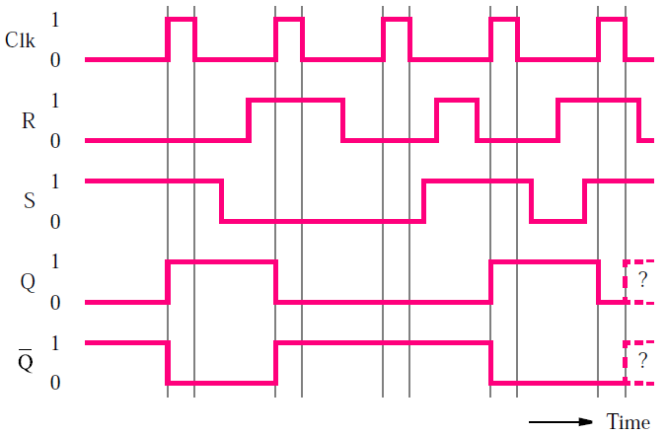
Gated SR latch with NOR gates
Timing diagram

Slide 14
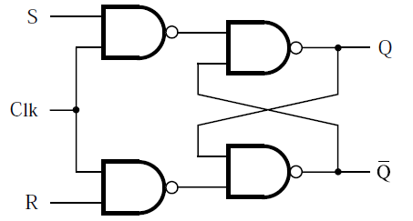
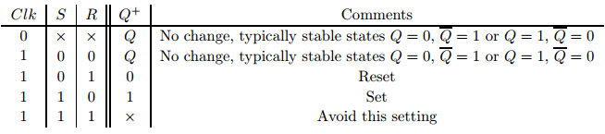
Gated SR latch with NAND gates
Circuit
Same circuit symbol and characteristic table
Source: http://ecse.bd.psu.edu/cse271/memelem.pdf

Slide 15
Summary: gated SR latch
Two implementations
  NOR gates
  NAND gates
    Preferred (requires fewer transistors)

Slide 16
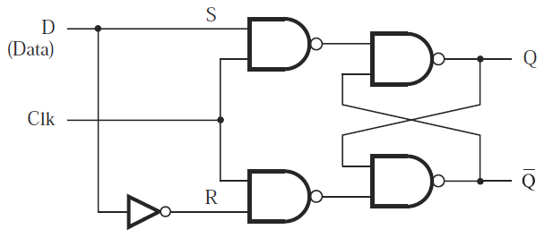
Gated D latch
Only one input: D (data)
Functionality
  Clk=1: output (Q) follows input (D)
  Clk=0: Q holds its previous value
Circuit

Slide 17
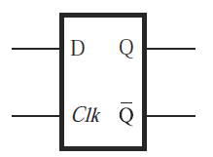
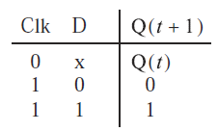
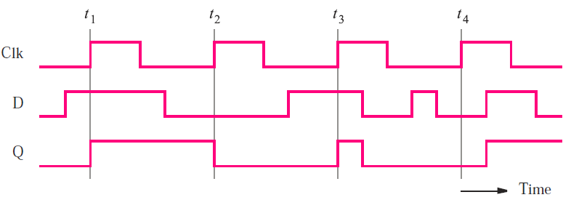
Gated D latch
Circuit symbol and characteristic table
Timing diagram

Slide 18
Level sensitive circuits
Level sensitive circuits
  Circuit output is controlled by clock level
  Circuit output keeps changing according to inputs when clock is active
  Circuit output value may change multiple times when clock is active
Examples
  Gated SR latch
  Gated D latch
  Clock is active high: Clk=1

Slide 19
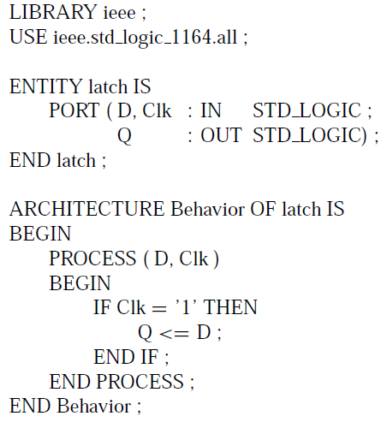
VHDL code for gated D latch

Slide 20
Flip-Flops
Edge triggered circuits
  Output only changes at clock edges (i.e., clock changes from one value to the other)
  Positive edge: clock changes from 0 to 1
  Negative edge: clock changes from 1 to 0
  Output value changes no more than once during one clock cycle
Examples
  D flip-flop
  T flip-flop
  JK flip-flop

Slide 21
D flip-flops
Operation
  Output follows input at active clock edge
Implementations
  Master-slave D flip-flop
    Output changes at negative edge of clock
    Output changes at positive edge of clock
  Edge-triggered D flip-flop
    Positive-edge-triggered
    Negative-edge-triggered

Slide 22
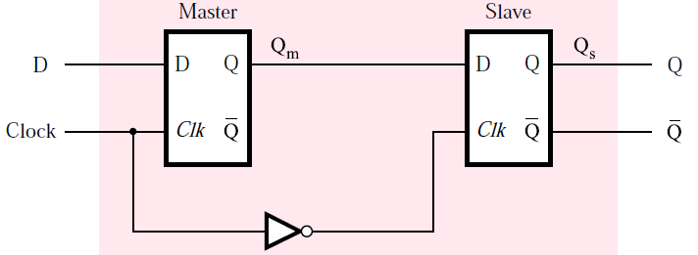
Master-slave D flip-flop: negative edge
Master-slave D flip-flop: negative edge
  Built on 2 gated D latches: master and slave
  Clock: original for master and complement for slave
  Output changes at negative edge of clock

Slide 23
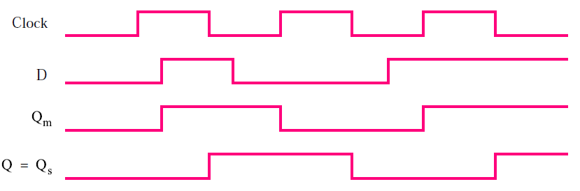
Master-slave D flip-flop: negative edge
Operation and timing diagram
  While Clock=1
    Master is active
    Q_{m} follows D
    Q_{s} remains unchanged
  While Clock=0
    Slave is active
    Q_{s} responds to Q_{m}, Q (final output) changes at negative edge

Slide 24
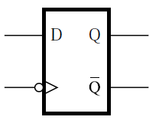
Master-slave D flip-flop: negative edge
Circuit symbol
  Symbol “>” denotes active edge of clock
  Bubble on clock indicates negative edge

Slide 25
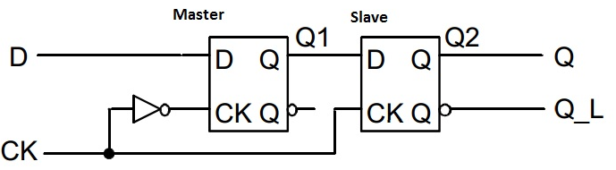
Master-slave D flip-flop: positive edge
Master-slave D flip-flop: positive edge
  Built on 2 gated D latches: master and slave
  Clock: complement for master and original for slave
  Output changes at positive edge of clock
Source: https://allthingsvlsi.files.wordpress.com/2013/04/master-slave-dff.jpg

Slide 26
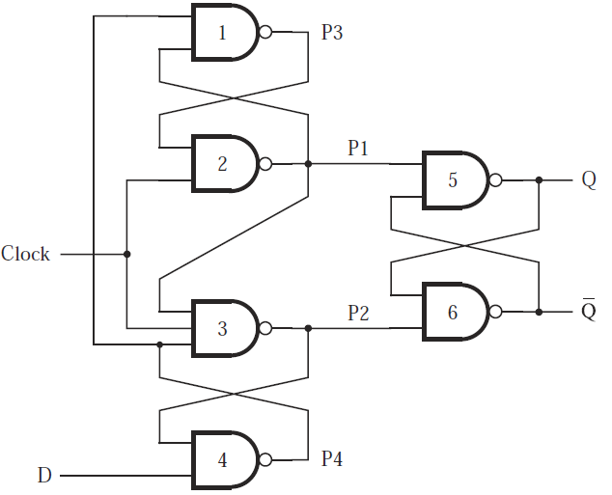
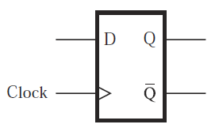
Edge-triggered D flip-flop: positive
Circuit and circuit symbol

Slide 27
Edge-triggered D flip-flop: positive
Clock=0
  P1=1, P2=1, basic S’R’ latch holds
  P4=D’, P3=D
Positive edge
  P1=(P3 AND Clock)’=D’
  P2=(P1 AND Clock AND P4)’=D
  Q=P1’=D, Q’=P2’=D’ (latch: S’=P1, R’=P2)

Slide 28
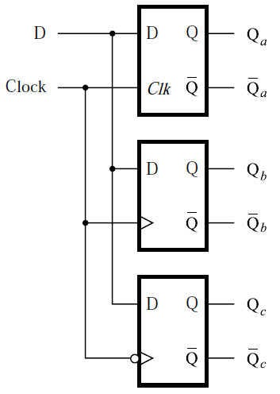
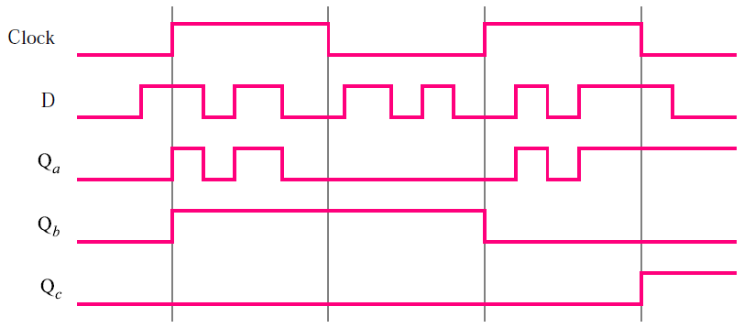
D: latch vs. flip-flop
Top to bottom
  Gated D latch (level sensitive)
  Positive-edge-triggered flip-flop
  Negative-edge-triggered flip-flop

Slide 29
D flip-flops with CLEAR and PRESET
Control signals: CLEAR and PRESET
  Use CLEAR to set initial condition Q=0
  Use PRESET to set initial condition Q=1
Implementations
  Based on master-slave D flip-flop
  Based on edge-triggered D flip-flop

Slide 30
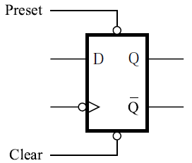
Master-slave D flip-flop with CLEAR and PRESET
CLEAR and PRESET are active low
  CLEAR=0: Q=0
  PRESET=0: Q=1
  CLEAR=1 or PRESET=1: no effect
Circuit symbol (negative edge)

Slide 31
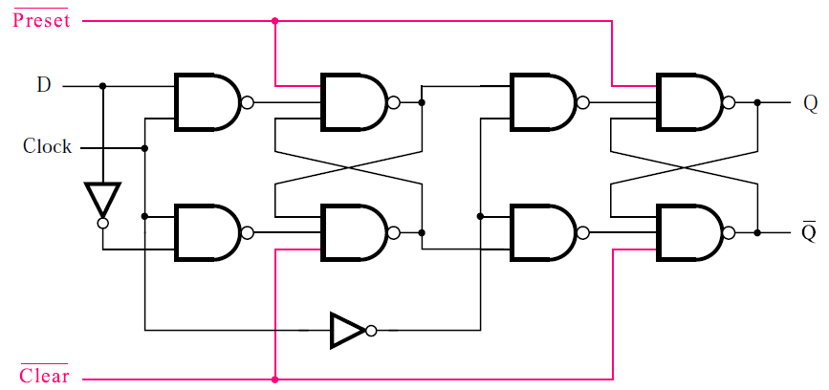
Master-slave D flip-flop with CLEAR and PRESET
Circuit: modified master-slave D flip-flop

Slide 32
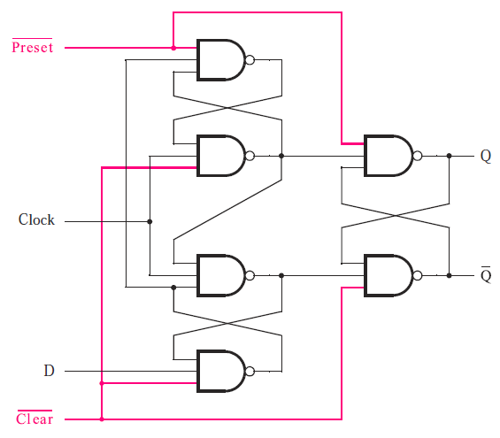
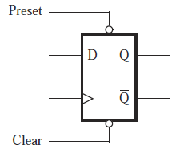
Edge-triggered D flip-flop with CLEAR and PRESET
Circuit and circuit symbol (positive edge)

Slide 33
Asynchronous vs. synchronous CLEAR
Asynchronous CLEAR
  If CLEAR=0, flip-flop will be cleared to Q=0 immediately without regard to clock
Synchronous CLEAR
  If CLEAR=0, flip-flop will be cleared to Q=0 at the next clock edge (positive or negative)

Slide 34
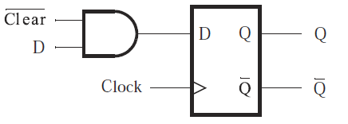
Synchronous CLEAR
Circuit

Slide 35
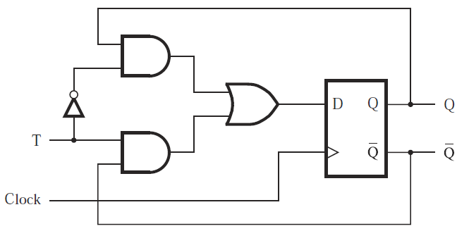
T flip-flop
T flip-flop
  T=0: state does not change
  T=1: state is reversed
Circuit

Slide 36
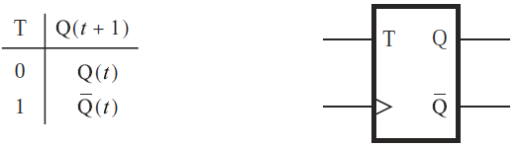
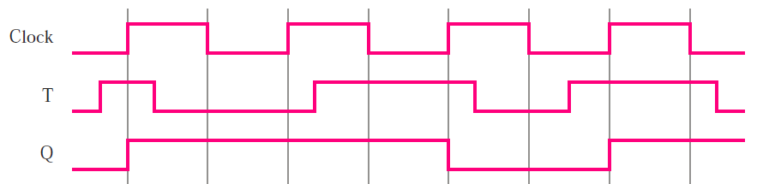
T flip-flop
Characteristic table and circuit symbol
Timing diagram

Slide 37
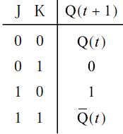
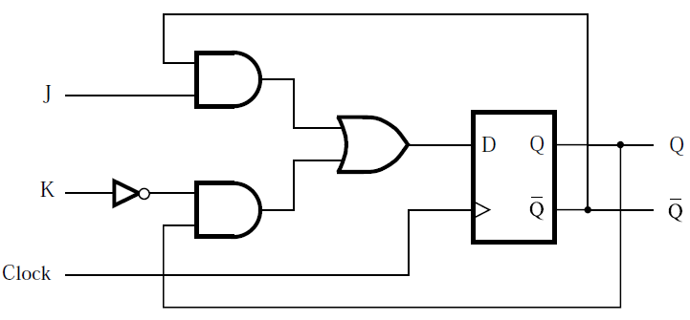
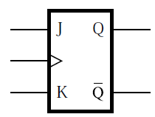
JK flip-flop
JK flip-flop
  Combines behaviors of basic SR latch and T flip-flop
  J: set, K: reset
Circuit, characteristic table, and circuit symbol

Slide 38
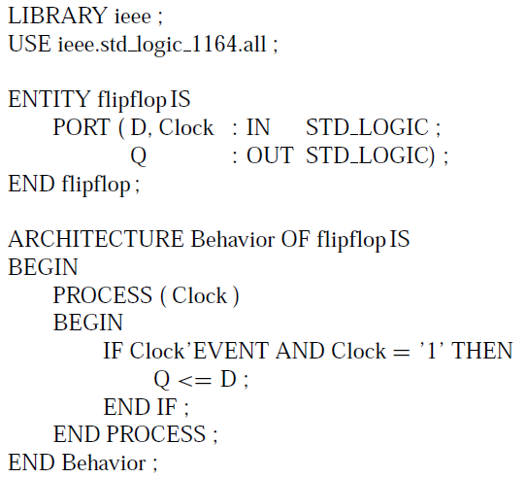
Code for D flip-flop (positive edge)
Code
  Sensitivity list: Clock
  ’EVENT: signal attribute
  Clock’EVENT: any change in the Clock signal
  Clock’EVENT AND Clock=‘1’: clock signal value has changed and the value is now 1 (positive edge)

Slide 39
Comparison: VHDL code for gated D latch

Slide 40
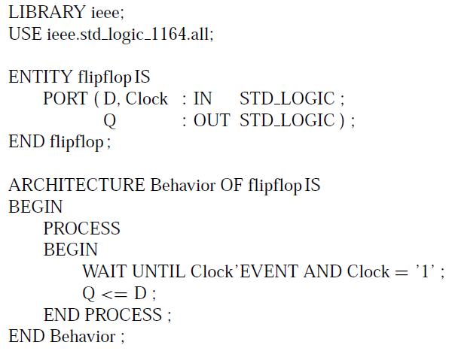
Alternative code for D flip-flop (positive edge)
Alternative code
  Sensitivity list: omitted
  WAIT UNTIL: implying that sensitivity list only includes clock signal
  Some VHDL tools accept a simplified WAIT UNTIL statement (i.e., Clock’EVENT is redundant and removed): WAIT UNTIL Clock=‘1’

Slide 41
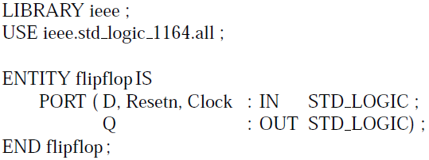
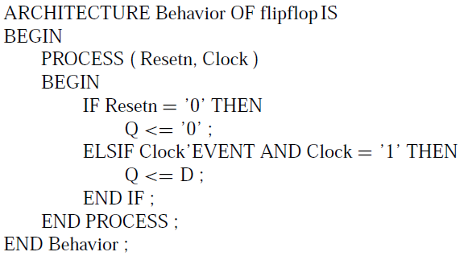
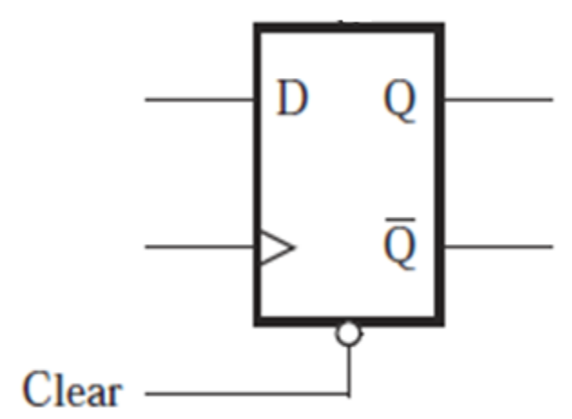
Code for D flip-flop with asynchronous reset (clear)
Asynchronous reset (clear): active low

Slide 42
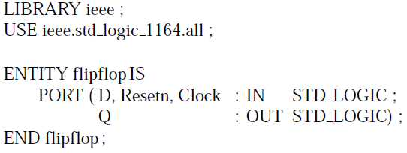
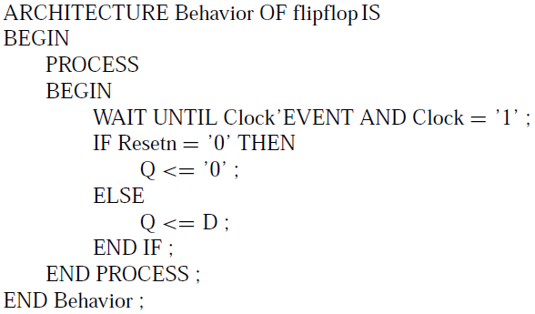
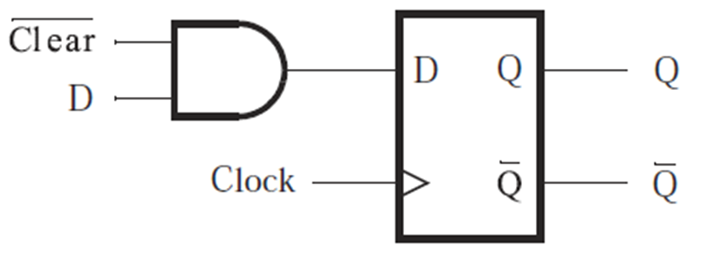
Code for D flip-flop with synchronous reset (clear)
Synchronous reset (clear) acts at clock edge

Slide 43
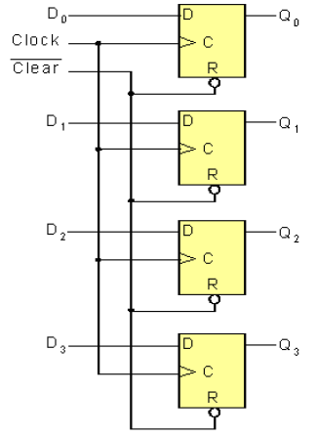
Registers
An N-bit register is a set of N flip-flops used to store N bits of information.
Example: 4-bit register
  One D flip-flop for each bit
  Same Clock and Clear signals for all 4 D flip-flops
  Input: D₀-D₃
  Output: Q₀-Q₃

Slide 44
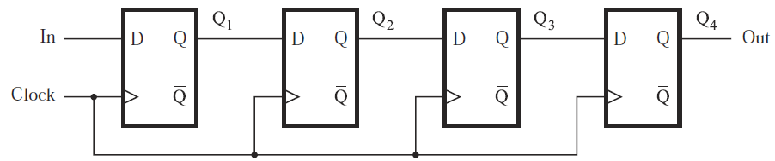
Shift registers
Shift register: a register with the ability to shift its contents
Example: 4-bit shift register

Slide 45
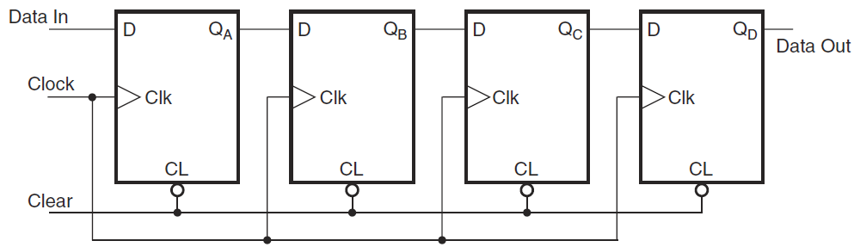
4-bit shift register
Circuit diagram (with asynchronous clear)
Timing diagram (next page)
  Input: 1 (first bit), 0, 0, 1 (last bit)

Slide 46


Slide 47

4-bit shift register
Contents of flip-flops
  Input is shifted to the right by one bit during each clock cycle
  An input bit propagates to output after 4 clock cycles
  4 clock cycles to load input, another 4 cycles to read output

Slide 48


4-bit registers: shift-right and shift-left
Shift-right
Shift-left

Slide 49
Shift register types
4 types depending on the method to load and read data
  Serial-in serial-out (SISO)
  Serial-in parallel-out (SIPO)
  Parallel-in serial-out (PISO)
  Parallel-in parallel-out (PIPO)

Slide 50

Shift register types

Slide 51

Parallel-access (parallel-loading) shift register
Circuit structure
  Top (D flip-flops): register
  Bottom (2 AND + 1 OR gates): 2-to-1 mux
Mode selection signal:
  Value 0: shift register
    Serial input is selected: serial input to D₃ (D input of leftmost flip-flop), Q₃ to D₂, Q₂ to D₁, Q₁ to D₀
    Shift-right register
  Value 1: parallel loading
    Parallel input is selected

Slide 52


Slide 53

Code for 8-bit register with asynchronous clear

Slide 54
Comparison: Code for D flip-flop with asynchronous reset (clear)
Asynchronous reset (clear): active low

Slide 55

Code for N-bit register with asynchronous clear

Slide 56
Code for N-bit register with asynchronous clear
GENERIC (N: INTEGER := 16)
  Define a parameter (N), its type (INTEGER), and its value (16)
  Assignment operator: “:=”
Q <= (OTHERS => ‘0’)
  Reset all bits of Q to 0 regardless of the bit length of Q
  For N=16, this statement is equivalent to Q<=“0000000000000000”

Slide 57
Structural code for 4-bit parallel-access shift register
Component: a D flip-flop with a 2-to-1 MUX on D input

Slide 58


Structural code for 4-bit parallel-access shift register: component
Sel: mode selection
  Sel=0: D=D0 (left-hand AND is active, left signal is selected: serial input or preceding Q)
  Sel=1, D=D1 (right-hand AND is active, right signal is selected: parallel input)

Slide 59

Structural code for 4-bit parallel-access shift register: entire circuit
R: parallel input, L: mode selection, w: serial input

Slide 60



Behavioral code for 4-bit parallel-access shift register

Slide 61



Behavioral code for N-bit parallel-access shift register
FOR LOOP: generate a set of sequential statements

Slide 62
Counters
Asynchronous (serial or ripple): different stages are driven by different clocks
  Up-counters
  Down-counters
Synchronous (parallel): different stages are driven by the same clock
  Up-counters
  Down-counters

Slide 63
Asynchronous up-counter with T flip-flops
A 3-bit up-counter
  It counts the number of clock cycles
  Stage 1 is driven by Clock, stages 2 and 3 are driven by preceding output complement
  Counter output: Q₂Q₁Q₀ (MSB to LSB)
  Counter modulus (MOD number): number of different logic states represented by counter
  Modulo-8 or MOD-8: states 0-7
  Asynchronous (serial or ripple): three stages respond after different delays

Slide 64


Asynchronous up-counter with T flip-flops

Slide 65


Asynchronous down-counter with T flip-flops

Slide 66


Synchronous up-counter with T flip-flops
Bit pattern: a given stage changes only when all the preceding stages satisfy Q=1
  Q₀ changes at each clock positive edge
  Q₁ changes only when Q₀=1
  Q₂ changes only when Q₀=1 AND Q₁=1
T input

Slide 67


4-bit synchronous up-counter with T flip-flops

Slide 68

4-bit synchronous down-counter with T flip-flops

Slide 69

Enable and clear capabilities
4-bit synchronous up-counter with T flip-flops
  Clear=0: reset counter output to 0 (clear is asynchronous)
  T inputs: T₀=Enable, T₁=Q₀·Enable, T₂=Q₁·Q₀·Enable, T₃=Q₂·Q₁·Q₀·Enable
  Enable=1: normal operation as counter
  Enable=0: hold current state (all T inputs are 0)

Slide 70



Synchronous counter with D flip-flop
D input
Operation (stage 0)
  A=Enable, B=Q₀
  Enable=1
    D₀=Q₀’, Q₀ flips
  Enable=0
    D₀=Q₀, Q₀ holds

Slide 71

Synchronous counter with parallel loading
2-to-1 mux
  Load: mode selection signal
  Load=0: normal counter
  Load=1: load D₃D₂D₁D₀

Slide 72
Reset synchronization
Reset counter during its normal operation
Modulus (MOD number) of an N-bit counter is NOT always 2^{N}
A modulo-6 (MOD-6) counter
  States (counts): 0, 1, 2, 3, 4, 5
  Reset is needed when count reaches 5
  Synchronous reset
  Asynchronous reset

Slide 73

Synchronous reset
Reset: implemented using parallel loading mode
Reset condition: Q₂Q₁Q₀=101 (count 5)
Load=1 when Q₂=Q₀=1: load D₂D₁D₀=000 (reset counter)
Reset is synchronized by clock

Slide 74

Synchronous reset
Timing diagram

Slide 75
Asynchronous reset
Reset: implemented using asynchronous clear signal generated by NAND gate
Reset condition: Q₂Q₁Q₀=101 (count 5)
Circuit modifications
  NAND gate: use Q₂=Q₀=1 to generate asynchronous clear signal (active low)
  Asynchronous clear: reset flip-flops
Reset is NOT synchronized by clock

Slide 76

Asynchronous reset
Original counter (4-bit synchronous)
Modified counter with asynchronous reset (MOD-6)

Slide 77

Asynchronous reset
Timing diagram
  State “5” duration is shorter than a clock cycle

Slide 78




Code for 4-bit synchronous up-counter with asynchronous reset (clear) and enable
Ports
  Resetn: clear
  E: Enable
Signal
  Count: flip-flop outputs

Slide 79



Code for 4-bit synchronous up-counter with asynchronous reset and parallel loading
L: load
R: parallel data
Integer range: 4-bit

Slide 80



Code for 3-bit down-counter
Modulus: generic
E: enable
L: load
Initial count: modulus-1

